Slide 1
Ecommerce Product Details Page UX Case Study Prepared By: Yadnesh Pisolkar UI/UX Internship Project

Slide 2
Project Brief
The Ecommerce Product Details Page was designed to provide users with a simple, visually appealing, and efficient shopping experience.
Goals:
• View product information clearly
• Compare features easily
• Make purchase decisions quickly
• Improve user satisfaction

Slide 3
Problem Statement
Problems:
• Cluttered layouts
• Poor information hierarchy
• Difficult navigation
• Confusing purchase process
Goal:
Design a clean and user-friendly product details page.

Slide 4
User Persona
Rahul Sharma
Age: 24
Occupation: Student
Location: Pune/Mumbai
Goals:
• Purchase products quickly
• Compare features easily

Slide 5
User Journey
Visit Website →
Search Product →
View Product Details →
Read Features & Reviews →
Add To Cart →
Checkout →
Order Confirmation

Slide 6
Wireframes
Low Fidelity Wireframe
Product Image
Product Name
Product Price
Product Description
[ Add To Cart ]
Purpose: Define layout and content hierarchy.

Slide 7
Design Process
Research → User Analysis → Wireframing → UI Design → Prototype → Testing
User-centered design approach.

Slide 8
Final UI Design
Insert screenshots of your Ecommerce Product Details Page here.
Focus:
• Simplicity
• Visual hierarchy
• Easy navigation
• Responsive lay

Slide 9
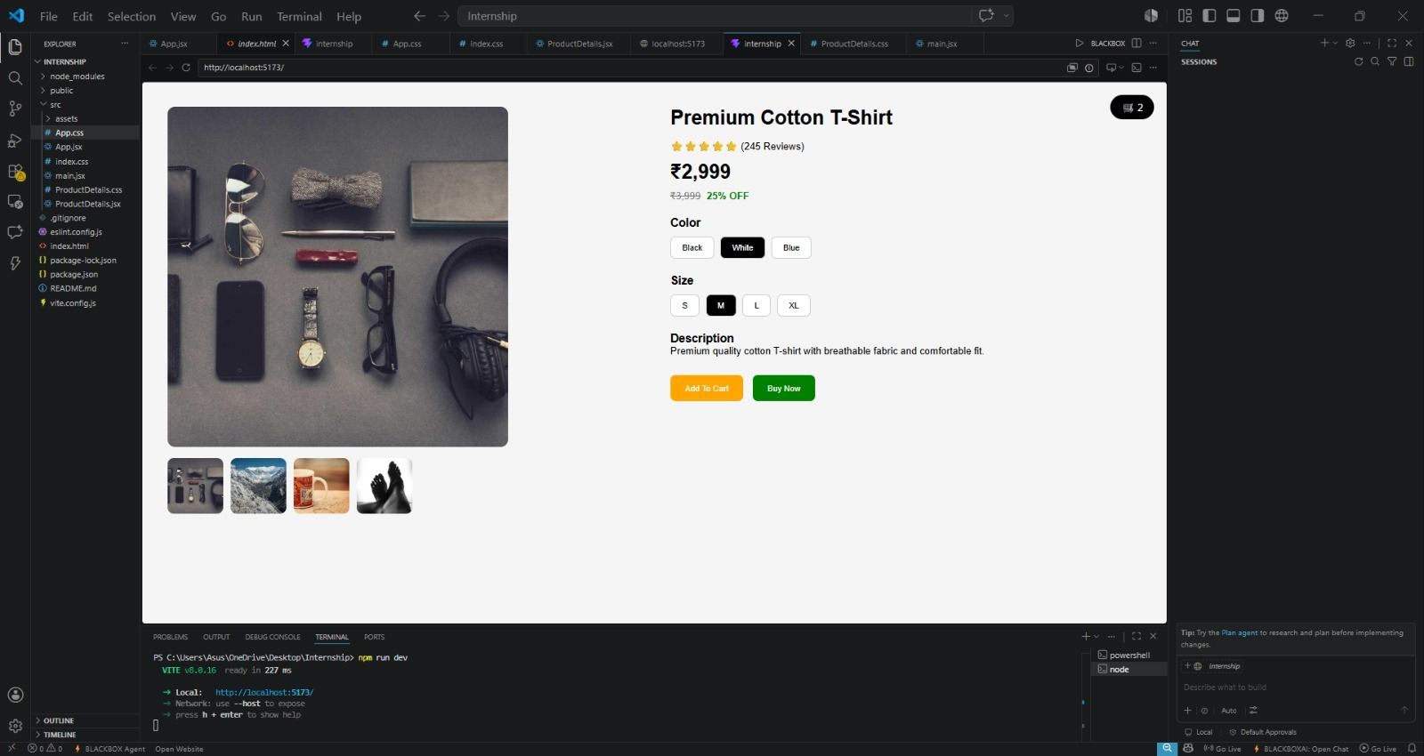
Screenshot of Project

Slide 10
Outcome & Learnings
Outcome:
✔ Better user experience
✔ Easy navigation
✔ Responsive interface
Learnings:
• UX Principles
• Wireframing
• Prototyping
• UI Design

Slide 11
Thank You!

